Slide 1


From Junior to Senior thru chosen chapters of software literature
TECHNICAL CAREER PATH
Ksenija Kordi Sokolić
unsplash.com - Beatriz Perez Moya

Slide 2





HOW WE STARTED

Slide 3
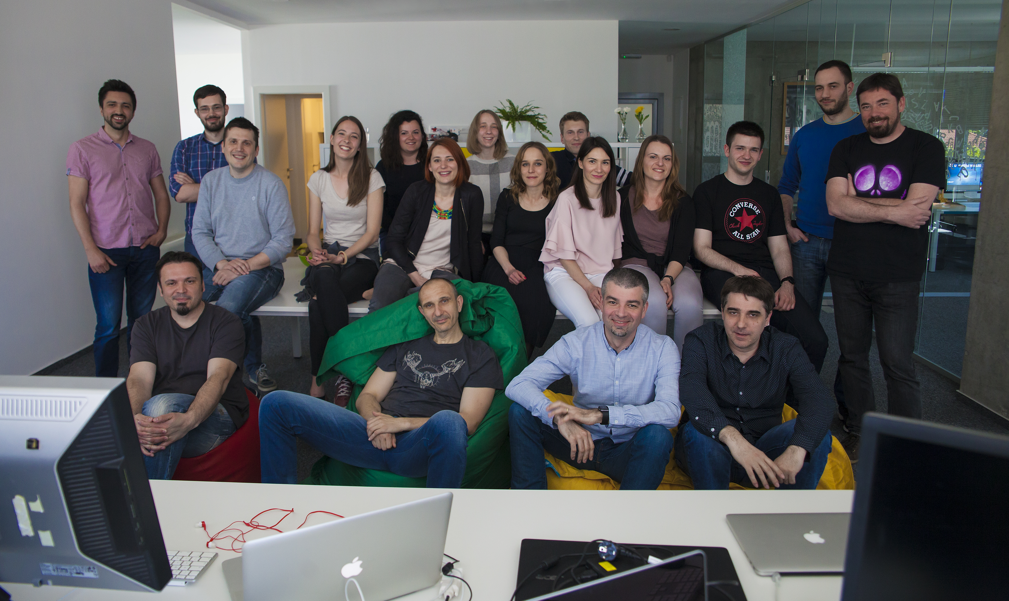
HOW WE STARTED

Slide 4

TECHNICAL CAREER PATH
Fellow
Principal
Senior
Independent
Junior

Slide 5

SKILL AREAS
Chosen technical field of expertise
Communication (soft skills)
PROBLEM SOLVING (thinking)
unsplash.com - Adam Sherez

Slide 6
Ten years of experience or the same year of experience ten times?

Slide 7
Software is imagined and created in your heads!

Slide 8

How can we help our younger colleagues enhance problem solving skills?
unsplash.com - Green Chameleon

Slide 9

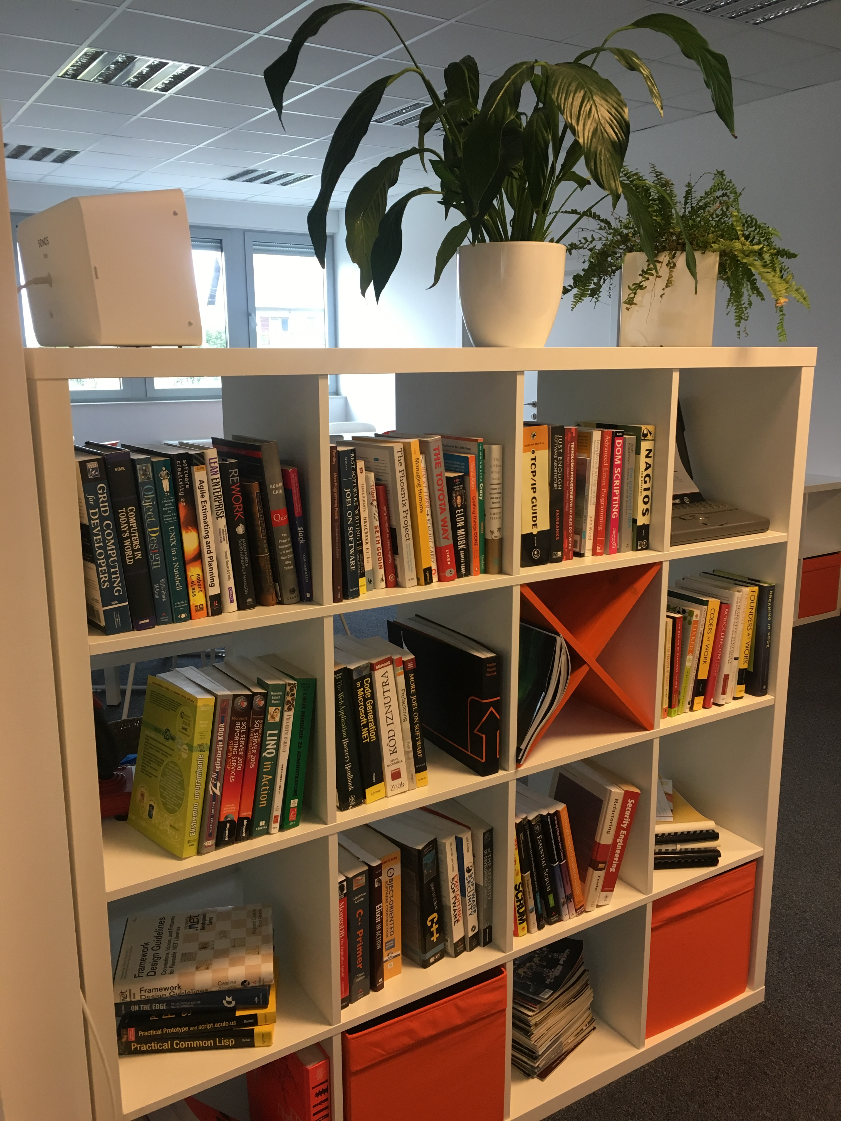

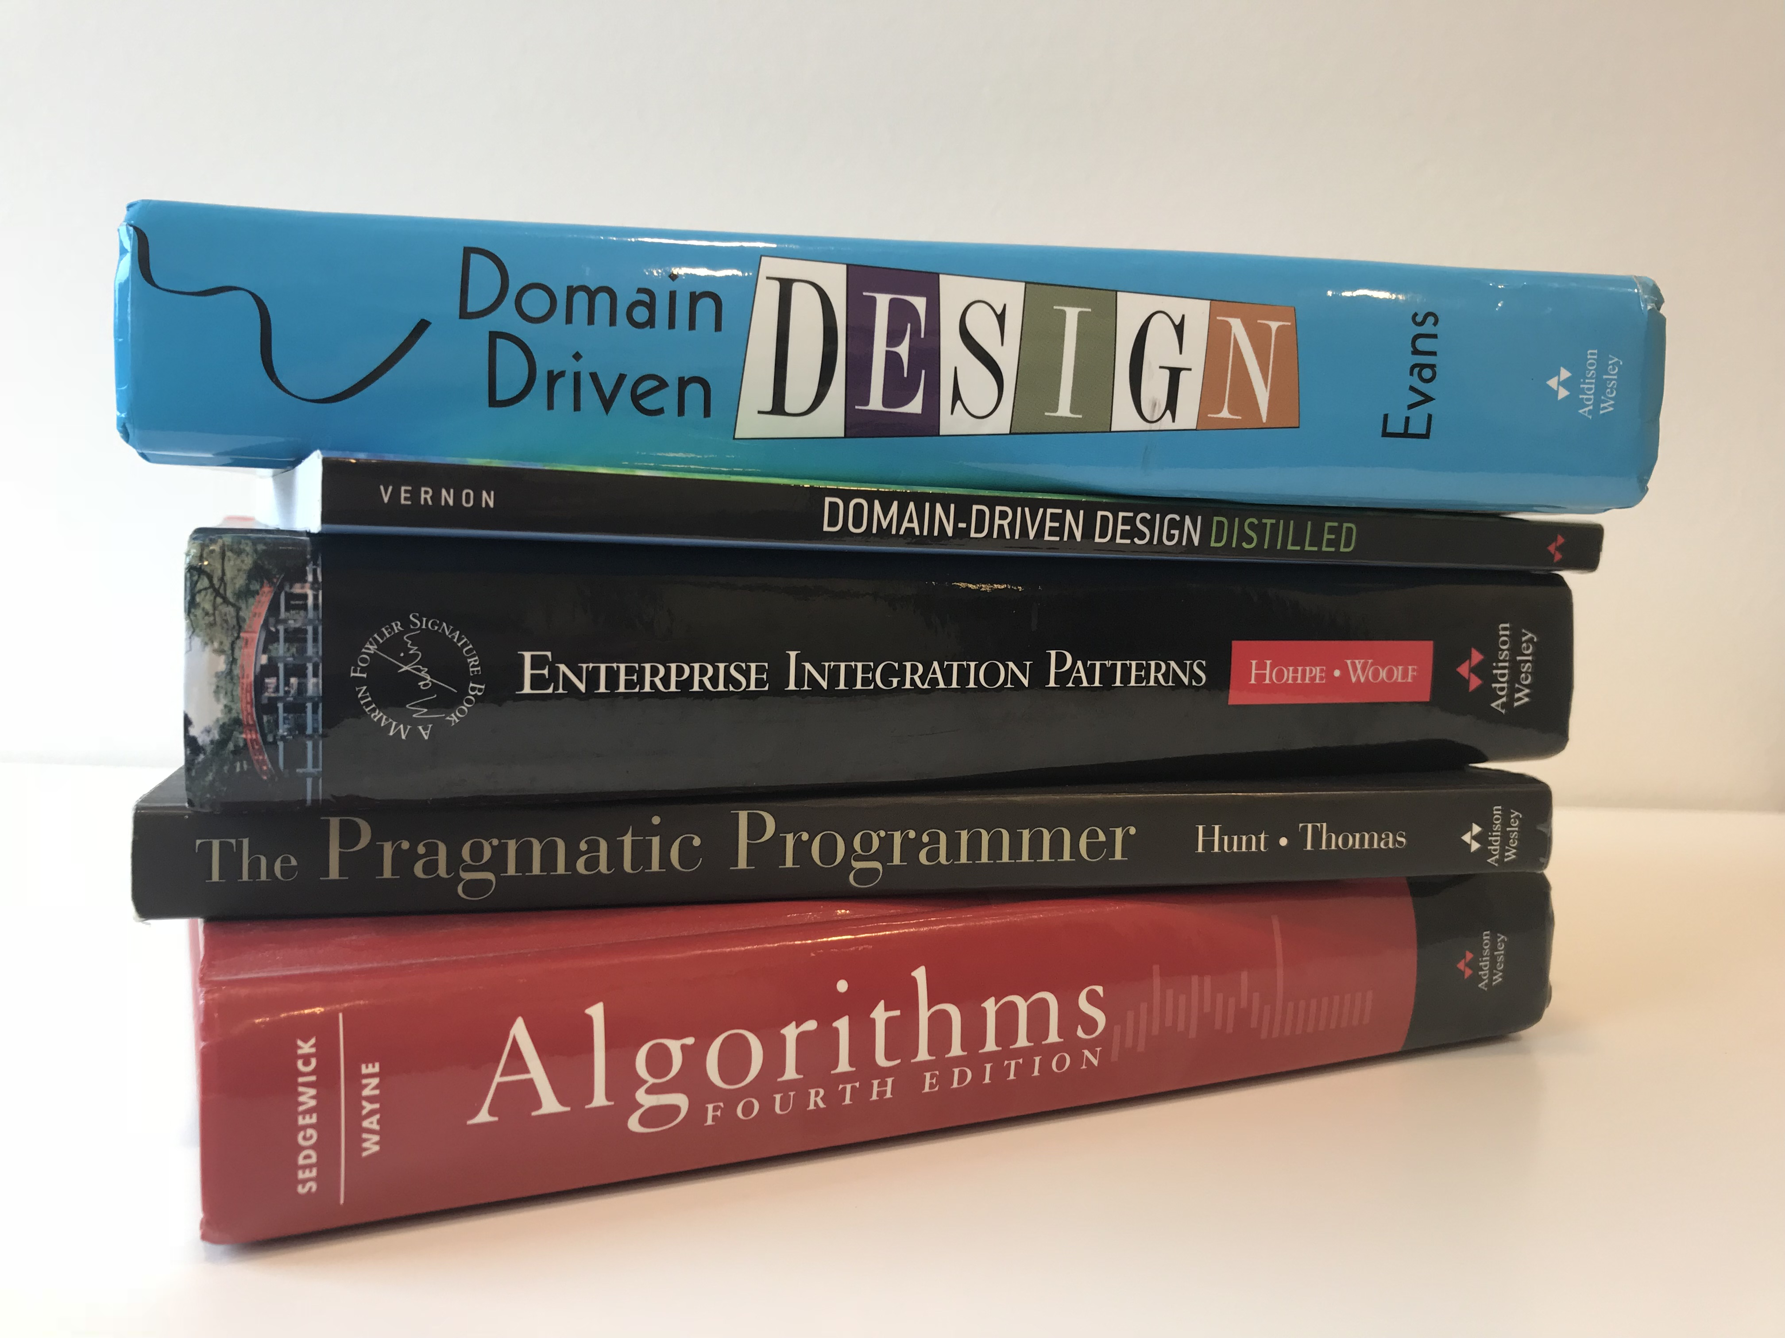
http://minus5.libib.com

Slide 10
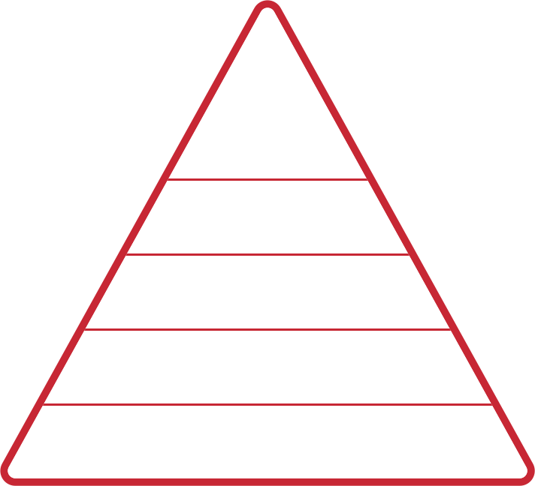
DREYFUS MODEL OF SKILL ACQUISITION
RELEVANT
FOCUS
META
COGNITIVE
ABILITY
INTUITION
EXPERT
PROFICIENT
COMPETENT
ADVANCED BEGINNER
CONSIDERS EVERYTHING
DOESN’T KNOW
WHAT DOESN’T
KNOW
NOVICE
RULES

Slide 11
JUNIORS
Want to accomplish an immediate goal
Want information fast
Still do not see “the big picture”
Learning Strategy: “Show me how” and “Help me do it better”

Slide 12
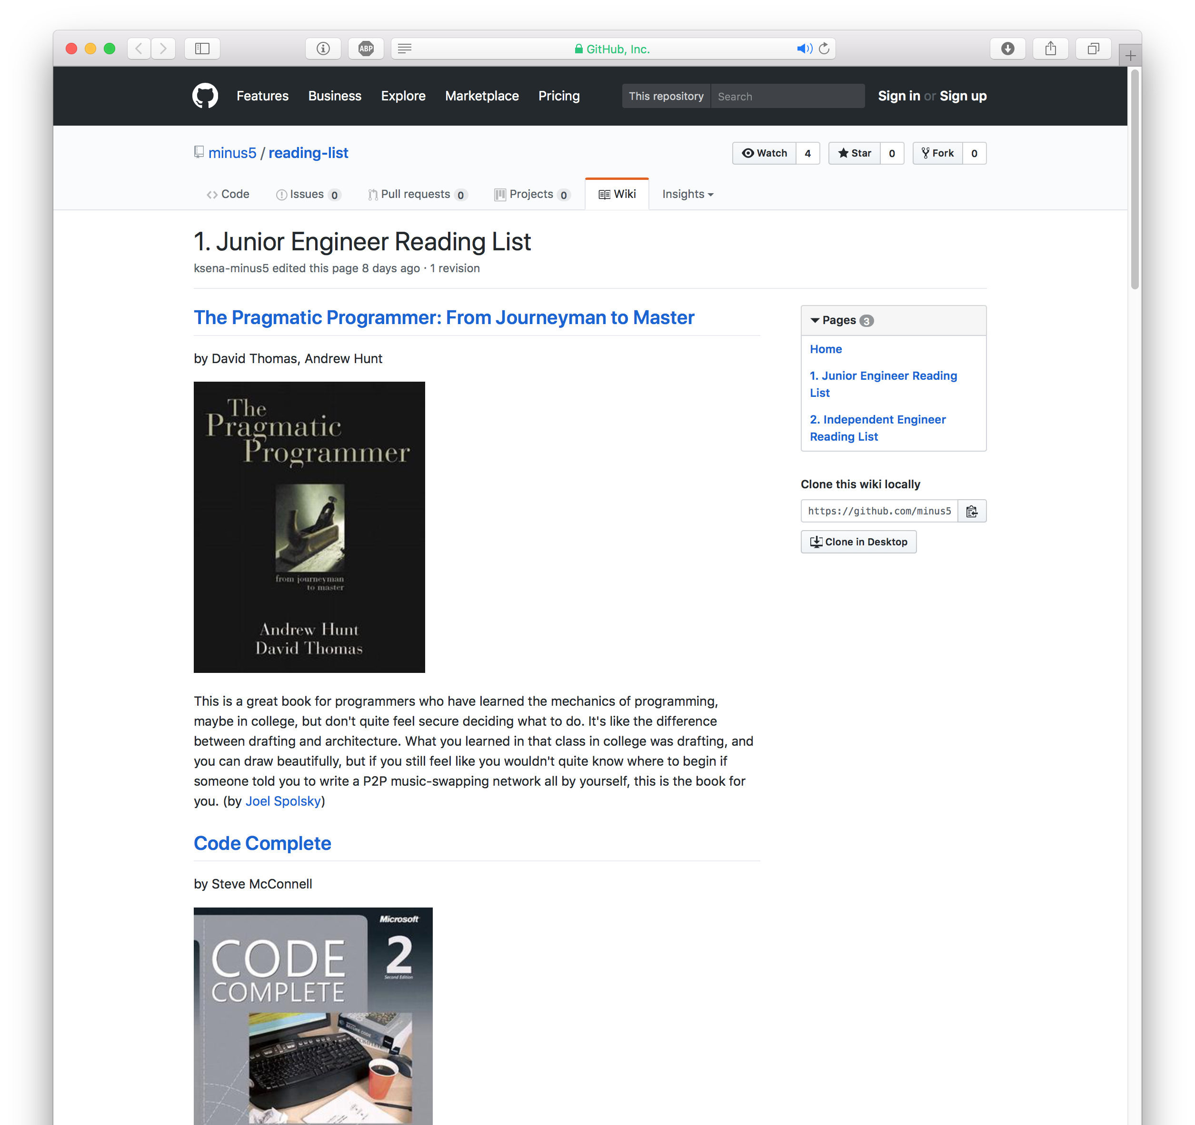
STARTER KIT
https://github.com/minus5/reading-list/wiki/1.-Junior-Engineer-Reading-List

Slide 13







Slide 14
AND BEYOND - INDEPENDENTS
Can troubleshoot problems on their own
Will seek out and solve problems
Learning Strategy: “Help me find what I need”

Slide 15




Independents list: https://github.com/minus5/reading-list/wiki/2.-Independent-Engineer-Reading-List

Slide 16
SENIORS
Need the big picture
Can correct previous poor task performance
Can learn from the experience of others
Learning Strategy: “I create my own learning”

Slide 17
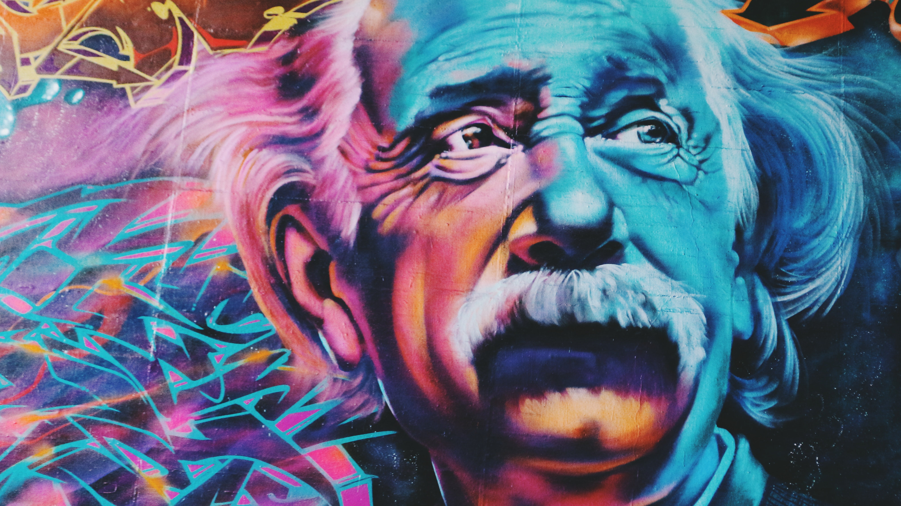

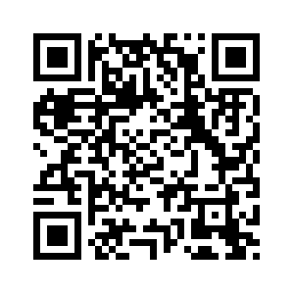
“You cannot solve a problem from the same consciousness that created it. You must learn to see the world anew.”
Albert Einstein
ksenija.kordi-sokolic@minus5.hr
https://joind.in/talk/b599f
unsplash.com - Sidney-Perry

